Slide 1
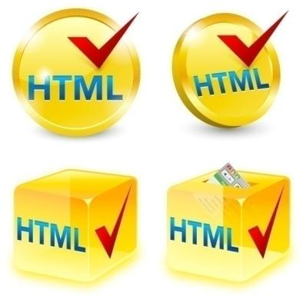
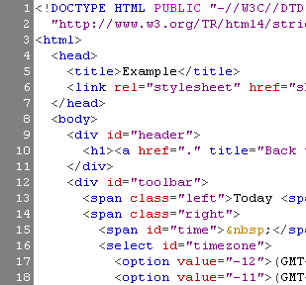
CHAPTER TWO HTML

Slide 2
Objectives
Define HTML
Know Basic Tags: Hyperlinks, Images, Formatting
Understand Headings and Paragraphs
Know the <!DOCTYPE> Declaration
Know the <head> Section: Title, Meta, Script, Style
Understand the <body> Section
Know the Lists: <ol>, <ul> and <dl>
Know the <div> and <span> elements
Understand how HTML Tables and HTML Forms are designed

Slide 3
What is web page?
A Web page is a document for the World Wide Web that is identified by URL.
A Web page can be accessed and displayed on a monitor or mobile device through a Web browser .
The data found in a Web page is usually in HTML or XHTML format.
The Web pages usually also contain other resources such as style sheets, scripts and images for presentation.

Slide 4
What is HTML?
It is short form of "HyperText Markup Language".
It is a language for describing web-pages using ordinary text.
HTML is not a complex programming language.
HTML Files
Every web page is actually a HTML file.
HTML file is just a plain-text file, with .html file extension instead of .txt, and
A web site will often contain many html files that link to each other.
Notes:
This declaration is an instruction, and it must be the first line of code in your HTML document. It tells the browser what type of document to expect, along with what version of HTML is being used in the document. For now, the browser will correctly assume that the html in <!DOCTYPE html> is referring to HTML5, as it is the current standard.
In the future, however, a new standard will override HTML5. To make sure your document is forever interpreted correctly, always include <!DOCTYPE html> at the very beginning of your HTML documents.
Lastly, HTML code is always saved in a file with an .html extension.

Slide 5
HTML vs. XHTML
Extensible Hypertext Markup Language (XHTML) :
It can be considered as a part of the HTML markup language this is because of XHTML have features of HTML.
XHTML is extended from and HTML.
XHTML can be considered as a better version of HTML.
HTML :
It is the most widely used language over the internet.
HTML is used to create web pages and link them from one to another.
HTML is not a programming language, it is a markup language.
We use different other technologies as like CSS and javascript to give a new look to the pages developed by HTML.

Slide 6
HTML Tags
HTML tags are the hidden keywords within a web page that define how your web browser must format and display the content
Most tags must have two parts,
an opening tag
a closing part tag
There are some tags that are an exception to this rule, and where a closing tag is not required. Eg <img>

Slide 7
Creating HTML Pages
An HTML file must have .html file extension
HTML files can be created using text editors:
NotePad,
NotePad ++,
Sublime
Comodo
Visual Studio etc..

Slide 8
HTML Structure
HTML is included of “elements” and “tags”
Begins with <html> and ends with </html>
Elements (tags) are nested one inside another:
Tags have attributes:
Eg , colore , size , height etc….
HTML describes structure using two main sections:
<head>
<body>
<html> <head></head> <body></body> </html>

Slide 9
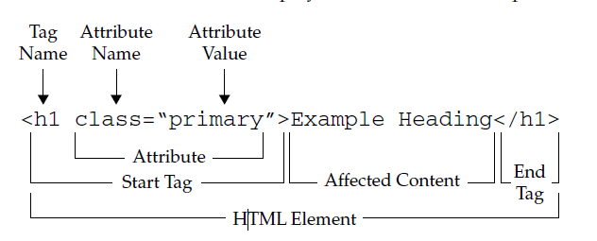
HTML Structure
A graphical overview of the HTML markup syntax shown is presented here:

Slide 10
HTML Code Formatting
The HTML source code should be formatted to increase readability and facilitate debugging.
Every block element should start on a new line.
Every nested (block) element should be indented.
For performance reasons, formatting can be sacrificed

Slide 11
First HTML Page
test.html
<!DOCTYPE html>
<html>
<head>
<title>My First HTML Page</title>
</head>
<body>
<p> Well came to my first HTML page</p>
</body>
</html>

Slide 12
The <!DOCTYPE> Declaration
All HTML documents must start with a <!DOCTYPE> declaration.
The declaration is not an HTML tag. It is an "information" to the browser about what document type to expect.
It informs the web browser about the type and version of HTML
HTML 4.01, XHTML 1.0 XHTML 1.1, HTML 5
It helps the browser to handle and load it properly.
Example:
The declaration is not case sensitive: <!DOCTYPE html>, <!DocType html>, <!Doctype html>, <!doctype html>
In HTML 5, the declaration is simple:
<!DOCTYPE html>
In older documents (HTML 4 or XHTML), the declaration is more complicated because the declaration must refer to a DTD (Document Type Definition).
HTML 4.01:
<!DOCTYPE HTML PUBLIC "-//W3C//DTD HTML 4.01 Transitional//EN" "http://www.w3.org/TR/html4/loose.dtd">
XHTML 1.1:
<!DOCTYPE html PUBLIC "-//W3C//DTD XHTML 1.1//EN" "http://www.w3.org/TR/xhtml11/DTD/xhtml11.dtd">

Slide 13
Some Simple Tags
Hyperlink Tags
Image Tags
Text formatting tags
<a href="https://www.youtube.com/"
>Link to youtube </a>
<img src="logo.gif" alt="logo" />
This text is <em>emphasized.</em>
<br />new line<br />
This one is <strong>more emphasized.</strong>

Slide 14
Some Simple Tags – Example
some-tags.html
<!DOCTYPE html>
<html>
<head>
<title>Simple Tags example</title>
</head>
<body>
<a href="https://www.youtube.com/" title= “youtube site">This is a link.</a>
<br />
<img src="logo.gif" alt="logo" />
<br />
<strong>Bold</strong> and <em>italic</em> text.
</body>
</html>

Slide 15
Tags Attributes
Tags can have attributes
Attributes specify properties and behavior
Example:
Few attributes can apply to every element:
id, style, class, title
The id is unique in the document
Content of title attribute is displayed as hint when the element is hovered with the mouse
Attribute alt with value "logo"
<img src="logo.gif" alt="logo"/>
Notes:
id Attribute:
The id attribute uniquely identifies an element within an HTML document. Each id value must be unique within the document.
It's often used to target specific elements with CSS or JavaScript for styling or interactivity purposes.
class Attribute:
The class attribute allows you to assign one or more class names to an element, enabling you to apply styles or behavior to multiple elements with the same class.
Classes provide a way to group elements and apply consistent styles or behavior across them.
style Attribute:
The style attribute allows you to apply inline CSS styles directly to an element.
Inline styles take precedence over external or internal stylesheets and can be useful for making quick, localized styling changes.
title Attribute:
The title attribute provides additional information about an element, typically displayed as a tooltip when the user hovers over the element.
It's commonly used to provide supplementary information or descriptions for elements, such as explaining the purpose of a link or the content of an image.

Slide 16
Tags Attributes
</style>
</head>
<body>
<h2>Difference Between Class and ID</h2>
<p>A class name can be used by multiple HTML elements, while an id name must only be used by one HTML element within the page:</p>
<!-- An element with a unique id -->
<h1 id="myHeader">My Cities</h1>
<!-- Multiple elements with same class -->
<h2 class="city">London</h2>
<p>London is the capital of England.</p>
<h2 class="city">Paris</h2>
<p>Paris is the capital of France.</p>
<h2 class="city">Tokyo</h2>
<p>Tokyo is the capital of Japan.</p>
</body>
</html>
Difference between Id and class
<!DOCTYPE html>
<html>
<head>
<style>
/* Style the element with the id "myHeader" */
#myHeader {
background-color: lightblue;
color: black;
padding: 40px;
text-align: center;
}
/* Style all elements with the class name "city" */
.city {
background-color: tomato;
color: white;
padding: 10px;
}

Slide 17
Headings and Paragraphs
Heading Tags (h1 – h6)
Paragraph Tags
Sections: div and span
<h1>Heading 1</h1>
<h2>Sub heading 2</h2>
<h3>Sub heading 3</h3>
<p>This is my first paragraph</p>
<p>This is my second paragraph</p>
<div style="background: skyblue;">
This is a div</div>

Slide 18
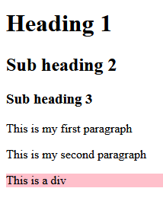
Headings and Paragraphs – Example
headings.html
<!DOCTYPE HTML>
<html>
<head><title>Headings and paragraphs</title></head>
<body>
<h1>Heading 1</h1>
<h2>Sub heading 2</h2>
<h3>Sub heading 3</h3>
<p>This is my first paragraph</p>
<p>This is my second paragraph</p>
<div style="background:pink">
This is a div</div>
</body>
</html>
Notes:
The <span> tag is much like <div> element, but <div> is a block level element and <span> is an inline element
One of the most popular elements in HTML is the <div> element. <div> is short for “division” or a container that divides the page into sections. These sections are very useful for grouping elements in your HTML together.

Slide 19
Headings and Paragraphs
<!DOCTYPE html>
<html>
<head>
<style>
.myDiv {
border: 5px outset red;
background-color: lightblue;
text-align: center;
}
</style>
</head>
<body>
<h1>The div element</h1>
<div class="myDiv">
<h2>This is a heading in a div element</h2>
<p>This is some text in a div element.</p>
</div>
<p>This is some text outside the div element.</p>
</body>
</html>
<div>
Notes:
The <span> tag is much like <div> element, but <div> is a block level element and <span> is an inline element

Slide 20
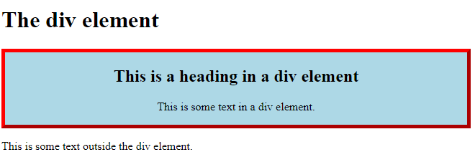
Headings and Paragraphs
<div> output
Notes:
The <span> tag is much like <div> element, but <div> is a block level element and <span> is an inline element

Slide 21
The <head> Section
Contains information that doesn’t show directly on the viewable page
Begins with <head> and ends with </head>
Contains mandatory single <title> tag
Can contain some other tags, e.g.
<meta>
<script>
<link>
<style>
<!–- comments -->

Slide 22
Header
HTML header
<!DOCTYPE html>
<html>
<head>
<title>My First HTML Page</title>
</head>
<body>
<p>This is some text...</p>
</body>
</html>

Slide 23
<head> Section: <title> tag
Title should be placed between <head> and </head> tags
Used to specify a title in the window title bar
Search engines and people rely on titles
<head>
<title>here is the title section </title>
</head>

Slide 24
<head> Section: <meta>
Meta tags additionally describe the content contained within the page
<meta> tags are typically used to specify character set, page description, author of the document.
Metadata is used by browsers (how to display content or reload page), search engines (keywords), and other web services.
<head>
<meta charset="UTF-8">
<meta name="viewport" content="width=device-width, initial-scale=1.0">
<title>Document</title>
</head>

Slide 25
<head> Section: <script>
The <script> element is used to embed scripts into an HTML document
Script are executed in the client's Web browser
Scripts can live in the <head> and in the <body> sections
Supported client-side scripting languages:
JavaScript (it is not Java!)

Slide 26
The <script> Tag – Example
The <script> tag is used to embed a client-side script (JavaScript). scripts-example.html
<!DOCTYPE html>
<html>
<head>
<title>JavaScript Example</title>
<script type="text/javascript">
function sayHello() {
document.write("<p>Hello World!</p>");
}
</script>
</head>
<body>
<script type=
"text/javascript">
sayHello();
</script>
</body>
</html>

Slide 27
<head> Section: <style>
The <style> element embeds formatting information (CSS styles) into an HTML page
<!DOCTYPE html>
<html>
<head>
<style type="text/css">
p { font-size: 12pt; line-height: 12pt; }
p:first-letter { font-size: 200%; }
span { text-transform: uppercase; }
</style>
</head>
<body>
<p>Styles demo.<br />
<span>Test uppercase</span>.
</p>
</body>
</html>
style-example.html

Slide 28
<body> Section
The <body> section describes the viewable portion of the page
Starts after the <head> </head> section
Begins with <body> and ends with </body>
<html>
<head><title>Test page</title></head>
<body>
<!-- This is the Web page body -->
</body>
</html>

Slide 29
Comments: <!-- --> Tag
Comments can exist anywhere between the <html></html> tags
Comments start with <!-- and end with -->
<!–- Telerik Logo (a JPG file) -->
<img src="logo.jpg" alt=“Telerik Logo">
<!–- Hyperlink to the web site -->
<a href="http://telerik.com/">Telerik</a>
<!–- Show the news table -->
<table class="newstable">
...

Slide 30
Text Formatting
Text formatting tags modify the text between the opening tag and the closing tag
Ex. <b>Hello</b> makes “Hello” bold
<b></b> | bold
<i></i> | italicized
<u></u> | underlined
<sup></sup> | Sample^{superscript}
<sub></sub> | Sample_{subscript}
<strong></strong> | strong
<em></em> | emphasized
<pre></pre> | Preformatted text
<blockquote></blockquote> | Quoted text block
<del></del> | Deleted text – strike through
30

Slide 31
Hyperlinks: <a> Tag
Link to a document called form.html on the same server in the same directory:
Link to a document called parent.html on the same server in the parent directory:
Link to a document called cat.html on the same server in the subdirectory stuff:
<a href="form.html">Fill Our Form</a>
<a href="../parent.html">Parent</a>
<a href="stuff/cat.html">Catalog</a>

Slide 32
Hyperlinks: <a> Tag (2)
<a href="http://www.devbg.org" target="_blank">BASD</a>
Link to an external Web site:
Always use a full URL, including "http://", not just "www.somesite.com"
Link to an e-mail address:
<a href="mailto:bugs@example.com">
Please report bugs here (by e-mail only)</a>

Slide 33
Hyperlinks: <a> Tag (3)
Link to a document called apply-now.html
On the same server, in same directory
Using an image as a link button:
<a href="apply-now.html"><img
src="apply-now-button.jpg" /></a>

Slide 34
Hyperlinks and Sections
Link to another location in the same document:
Link to a specific location in another document:
<a href="#section1">Go to Introduction</a>
...
<h2 id="section1">Introduction</h2>
<a href="chapter3.html#section3.1.1">Go to Section 3.1.1</a>
<!–- In chapter3.html -->
...
<div id="section3.1.1">
<h3>3.1.1. Technical Background</h3>
</div>

Slide 35
Hyperlinks – Example
hyperlinks.html
<a href="form.html">Fill Our Form</a> <br />
<a href="../parent.html">Parent</a> <br />
<a href="stuff/cat.html">Catalog</a> <br />
<a href="http://www.devbg.org" target="_blank">BASD</a> <br />
<a href="mailto:bugs@example.com?subject=Bug Report">Please report bugs here (by e-mail only)</a>
<br />
<a href="apply-now.html"><img src="apply-now-button.jpg” /></a> <br />
<a href="../english/index.html">Switch to English version</a> <br />

Slide 36
Links to the Same Document – Example
links-to-same-document.html
<h1>Table of Contents</h1>
<p><a href="#section1">Introduction</a><br />
<a href="#section2">Some background</A><br />
<a href="#section2.1">Project History</a><br />
...the rest of the table of contents...
<!-- The document text follows here -->
<h2 id="section1">Introduction</h2>
... Section 1 follows here ...
<h2 id="section2">Some background</h2>
... Section 2 follows here ...
<h3 id="section2.1">Project History</h3>
... Section 2.1 follows here ...

Slide 37
Images: <img> tag
Inserting an image with <img> tag:
Image attributes:
Example:
<img src="/img/basd-logo.png">
src | Location of image file (relative or absolute)
alt | Substitute text for display (e.g. in text mode)
height | Number of pixels of the height
width | Number of pixels of the width
border | Size of border, 0 for no border
<img src="./php.png" alt="PHP Logo" />
37

Slide 38
Miscellaneous Tags
<hr/>: Draws a horizontal rule (line):
<center></center>:
<font></font>:
<hr size="5" width="70%" />
<center>Hello World!</center>
<font size="3" color="blue">Font3</font>
<font size="+4" color="blue">Font+4</font>

Slide 39
Miscellaneous Tags – Example
misc.html
<html>
<head>
<title>Miscellaneous Tags Example</title>
</head>
<body>
<hr size="5" width="70%" />
<center>Hello World!</center>
<font size="3" color="blue">Font3</font>
</body>
</html>

Slide 40
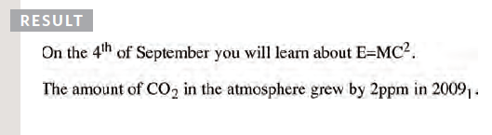
Superscript and Subscript
<sup>
The <sup> element is used
to contain characters that
should be superscript such
as the suffixes of dates or
mathematical concepts like
raising a number to a power such as 2².
<sub>
The <sub> element is used to
contain characters that should
be subscript. It is commonly
used with foot notes or chemical formulas such as H₂0.
<p>On the 4<sup>th</sup> of September you will learn
about E=MC<sup>2</sup>.</p>
<p>The amount of CO<sub>2</sub> in the atmosphere grew by 2ppm in 2009<sub>1</sub>.</p>

Slide 41
Ordered Lists: <ol> Tag
Create an Ordered List using <ol></ol>:
Attribute values for type are 1, A, a, I, or i
<ol type="1">
<li>Apple</li>
<li>Orange</li>
<li>Grapefruit</li>
</ol>
Apple
Orange
Grapefruit
Apple
Orange
Grapefruit
Apple
Orange
Grapefruit
Apple
Orange
Grapefruit
Apple
Orange
Grapefruit

Slide 42
Unordered Lists: <ul> Tag
Create an Unordered List using <ul></ul>:
Attribute values for type are:
disc, circle or square
<ul type="disk">
<li>Apple</li>
<li>Orange</li>
<li>Grapefruit</li>
</ul>
Apple
Orange
Pear
Apple
Orange
Pear
Apple
Orange
Pear

Slide 43
Definition lists: <dl> tag
Create definition lists using <dl>
Pairs of text and associated definition; text is in <dt> tag, definition in <dd> tag
Renders without bullets
Definition is indented
<dl>
<dt>HTML</dt>
<dd>A markup language …</dd>
<dt>CSS</dt>
<dd>Language used to …</dd>
</dl>

Slide 44
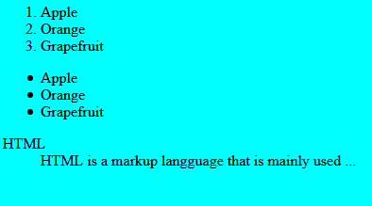
Lists – Example
lists.html
<ol type="1">
<li>Apple</li>
<li>Orange</li>
<li>Grapefruit</li>
</ol>
<ul type="disc">
<li>Apple</li>
<li>Orange</li>
<li>Grapefruit</li>
</ul>
<dl>
<dt>HTML</dt>
<dd>A markup lang…</dd>
</dl>

Slide 45
HTML Special Characters
Symbol Name
HTML Entity
Symbol
Copyright Sign
&copy;
©
Registered Trademark Sign
&reg;
®
Trademark Sign
&trade;
™
Less Than
&lt;
<
Greater Than
&gt;
>
Ampersand
&amp;
&
Non-breaking Space
&nbsp;
Em Dash
&mdash;
—
Quotation Mark
&quot;
"
Euro
&#8364;
€
British Pound
&pound;
£
Japanese Yen
&yen;
¥
45

Slide 46
Using <DIV> and <SPAN> Block and Inline Elements
Block elements add a line break before and after them
<div> is a block element
Other block elements are <table>, <hr>, headings, lists, <p> and etc.
Inline elements don’t break the text before and after them
<span> is an inline element
Most HTML elements are inline, e.g. <a>

Slide 47
The <div> Tag
<div> creates logical divisions within a page
Block style element
Used with CSS
Example:
div-and-span.html
<div style="font-size:24px; color:red">DIV example</div>
<p>This one is <span style="color:red; font-weight:bold">only a test</span>.</p>

Slide 48
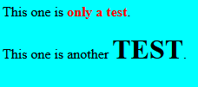
The <span> Tag
Inline style element
Useful for modifying a specific portion of text
Don't create a separate area (paragraph) in the document
Very useful with CSS
span.html
<p>This one is <span style="color:red; font-weight:bold">only a test</span>.</p>
<p>This one is another <span style="font-size:32px; font-weight:bold">TEST</span>.</p>

Slide 49
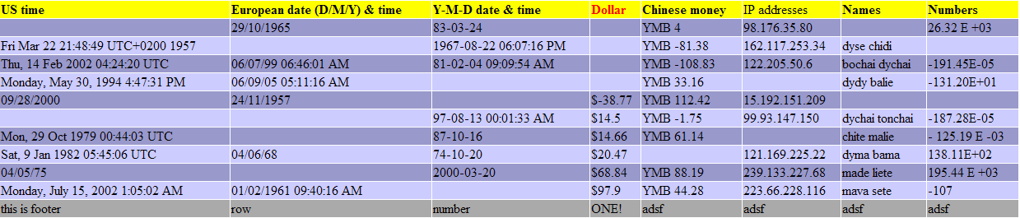
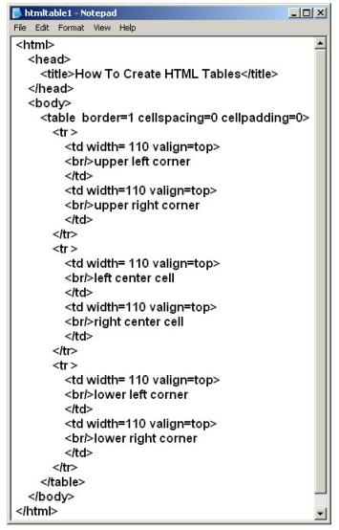
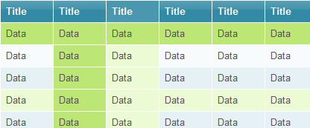
HTML Tables

Slide 50
HTML Tables
Tables represent tabular data
A table consists of one or several rows
Each row has one or more columns
Tables comprised of several core tags:
<table></table>: begin / end the table
<tr></tr>: create a table row
<td></td>: create tabular data (cell)
Tables should not be used for layout. Use CSS floats and positioning styles instead

Slide 51
HTML Tables (2)
Start and end of a table
Start and end of a row
Start and end of a cell in a row
<table> ... </table>
<tr> ... </tr>
<td> ... </td>

Slide 52
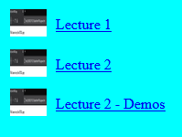
Simple HTML Tables – Example (2)
<table cellspacing="0" cellpadding="5">
<tr>
<td><img src="ppt.gif"></td>
<td><a href="lecture1.ppt">Lecture 1</a></td>
</tr>
<tr>
<td><img src="ppt.gif"></td>
<td><a href="lecture2.ppt">Lecture 2</a></td>
</tr>
<tr>
<td><img src="zip.gif"></td>
<td><a href="lecture2-demos.zip">
Lecture 2 - Demos</a></td>
</tr>
</table>

Slide 53
Complete HTML Tables
Table rows split into three semantic sections: header, body and footer
<thead> denotes table header and contains <th> elements, instead of <td> elements
<tbody> denotes collection of table rows that contain the very data
<tfoot> denotes table footer but comes BEFORE the <tbody> tag
<colgroup> and <col> define columns (most often used to set column widths)

Slide 54
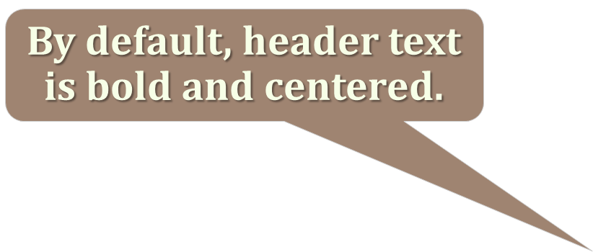
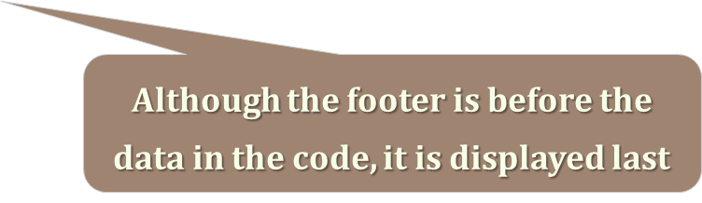
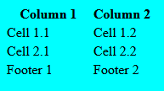
Complete HTML Table: Example
<table>
<colgroup>
<col style="width:100px" /><col />
</colgroup>
<thead>
<tr><th>Column 1</th><th>Column 2</th></tr>
</thead>
<tfoot>
<tr><td>Footer 1</td><td>Footer 2</td></tr>
</tfoot>
<tbody>
<tr><td>Cell 1.1</td><td>Cell 1.2</td></tr>
<tr><td>Cell 2.1</td><td>Cell 2.2</td></tr>
</tbody>
</table>
columns
header
th
footer
Last comes the body (data)

Slide 55
Cell Spacing and Padding
Tables have two important attributes:
cellspacing
Defines the empty space between cells
cellpadding
Defines the empty space around the cell content
cell
cell
cell
cell
cell
cell
cell
cell

Slide 56
Cell Spacing and Padding – Example
table-cells.html
<html>
<head><title>Table Cells</title></head>
<body>
<table cellspacing="15" cellpadding="0">
<tr><td>First</td>
<td>Second</td></tr>
</table>
<br/>
<table cellspacing="0" cellpadding="10">
<tr><td>First</td><td>Second</td></tr>
</table>
</body>
</html>

Slide 57
Column and Row Span
Table cells have two important attributes:
Colspan
Defines how many columns the cell occupies
rowspan
Defines how many rows the cell occupies
colspan="1"
colspan="1"
rowspan="2"
rowspan="1"
cell[1,1]
cell[1,2]
cell[1,1]
cell[1,2]
cell[2,1]
cell[2,1]
colspan="2"
rowspan="1"

Slide 58
Column and Row Span – Example
table-colspan-rowspan.html
<table cellspacing="0">
<tr class="1"><td>Cell[1,1]</td>
<td colspan="2">Cell[2,1]</td></tr>
<tr class=“2"><td>Cell[1,2]</td>
<td rowspan="2">Cell[2,2]</td>
<td>Cell[3,2]</td></tr>
<tr class=“3"><td>Cell[1,3]</td>
<td>Cell[2,3]</td></tr>
</table>
Cell[1,1]
Cell[2,1]
Cell[1,2]
Cell[2,2]
Cell[3,2]
Cell[1,3]
Cell[2,3]

Slide 59
HTML Forms
Forms are the primary method for gathering data from site visitors
Create a form block with
Example:
<form></form>
The “method" attribute tells how the form data should be sent – via GET or POST request
<form name="myForm" method="post" action="path/to/some-script.php">
...
</form>
The "action" attribute tells where the form data should be sent

Slide 60



HTML Forms
There are several types of form controls that you can use to collect information from visitors to your site.
ADDING TEXT:
Text input (single-line):Used for a single line of text such as email addresses and names.
Password input: Like a single line text box but it masks the characters entered.
Text area (multi-line): For longer areas of text, such as messages and comments

Slide 61
HTML Forms
With the get method, the values from the form are added to the end of the URL specified in the action attribute. The get method is ideal for:
short forms (such as search boxes)
when you are just retrieving data from the web server (not sending information that should be added to or deleted from a database)
With the post method the values are sent in what are known as HTTP headers. As a rule of thumb you should use the post method if your form:
allows users to upload a file
is very long
contains sensitive data (e.g. passwords)
adds information to, or deletes information from the database

Slide 62
HTML Forms
<input>
The <input> element is used to create several different form controls. The value of the type attribute determines what kind of input they will be creating
type="text"
When the type attribute has a value of text, it creates a single line text input.
name
When users enter information into a form, the server needs to know which form control each piece of data was entered into. (For example, in a login form, the server needs to know what has been entered as the username and what has been given as the password). Therefore, each form control requires a name attribute. The value of this attribute identifies the form control and is sent along with the information they enter to the server.

Slide 63

Form Fields
Single-line text input fields:
Multi-line textarea fields:
Hidden fields contain data not shown to the user:
Often used by JavaScript code
<input type="text" name="FirstName" value="This is a text field" />
<textarea name="Comments">This is a multi-line text field</textarea>
<input type="hidden" name="Account" value="This is a hidden text field" />

Slide 64
Form Input Controls
Checkboxes:
Radio buttons:
Radio buttons can be grouped, allowing only one to be selected from a group:
<input type="checkbox" name="fruit" value="apple" />
<input type="radio" name="title" value="Mr." />
<input type="radio" name="city" value="Lom" />
<input type="radio" name="city" value="Ruse" />

Slide 65
Other Form Controls
Dropdown menus:
Submit button:
<select name=“department">
<option value="Value 1"
selected="selected">cs</option>
<option value="Value 2">IS</option>
<option value="Value 3">IT</option>
</select>
<input type="submit" name="submitBtn" value="Apply Now" />

Slide 66
Other Form Controls (2)
Reset button – brings the form to its initial state
Image button – acts like submit but image is displayed and click coordinates are sent
Ordinary button – used for JavaScript, no default action
<input type="reset" name="resetBtn" value="Reset the form" />
<input type="image" src="submit.gif" name="submitBtn" alt="Submit" />
<input type="button" value="click me" />

Slide 67
Other Form Controls (3)
Password input – a text field which masks the entered text with * signs
Multiple select field – displays the list of items in multiple lines, instead of one
<input type="password" name="pass" />
<select name="products" multiple="multiple">
<option value="Value 1“ selected="selected">keyboard</option>
<option value="Value 2">mouse</option>
<option value="Value 3">speakers</option>
</select>

Slide 68
Other Form Controls (4)
File input – a field used for uploading files
Form labels are used to associate an explanatory text to a form field using the field's ID.
fieldsets are used to enclose a group of related form fields:
The <legend> is the fieldset's title
<input type="file" name="photo" />
<label for="fn">First Name</label>
<input type="text" id="fn" />

Slide 69
HTML Forms – Example
form.html
<form method="post" action="apply-now.php">
<input name="subject" type="hidden" value="Class" />
<fieldset style="width:150px"><legend>Academic information</legend>
<label for="degree">Degree</label>
<select name="degree" id="degree">
<option value="BA">Bachelor of Art</option>
<option value="BS">Bachelor of Science</option>
<option value="MBA" selected="selected">Master of
Business Administration</option>
</select>
<br /> <br>
<label for="studentid">Student ID</label>
<input type="password" name="studentid" />
</fieldset>
Notes:
for="fname": This attribute specifies which form element the label is associated with. The value of this attribute should match the id attribute of the form element it labels. In this case, it's associated with an input element with the id of "fname".
Text content: The text content between the opening and closing <label> tags provides the actual label text. In this example, it's "First Name".

Slide 70
form.html (continued)
<fieldset style="width:150px"><legend>Personal Details</legend>
<label for="fname">First Name</label>
<input type="text" name="fname" id="fname" />
<br>
<br>
<label for="lname">Last Name</label>
<input type="text" name="lname" id="lname" />
<br />
<br>
Gender:
<input name="gender" type="radio" id="gm" value="m" />
<label for="gm">Male</label>
<input name="gender" type="radio" id="gf" value="f" />
<label for="gf">Female</label>
<br /> <br>
<label for="email">Email</label>
<input type="text" name="email" id="email" />
</fieldset>

Slide 71
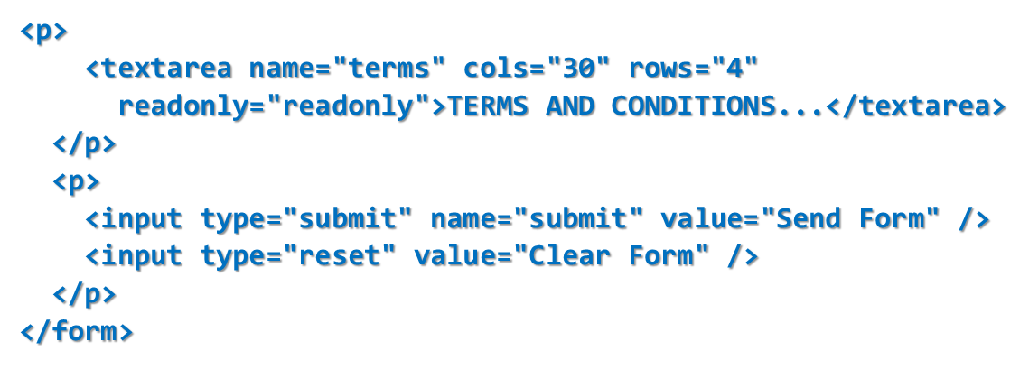
Cont..

Slide 72
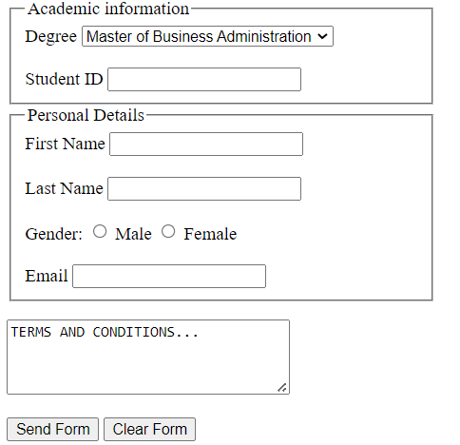
Cont..

Slide 73
How Forms Work
A user fills in a form and then presses a button to submit the information to the server
The name of each form control is sent to the server along with the value the user enters or selects.

Slide 74
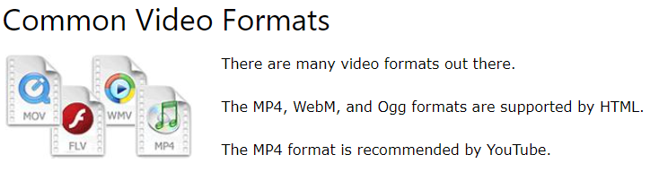
What is Multimedia?
Multimedia comes in many different formats. It can be almost anything you can hear or see, like images, music, sound, videos, records, films, animations, and more.

Slide 75
The HTML <video> Element
<div class="video-container">
<video width="320" height="240" controls>
<source src="movie.mp4" type="video/mp4">
<source src="movie.ogg" type="video/ogg">
Your browser does not support the video tag.
</video>
</div>

Slide 76
The HTML <audio> Element
<audio controls> <source src="horse.ogg" type="audio/ogg"> <source src="horse.mp3" type="audio/mpeg"> </audio>

Slide 77
HTML <audio> Autoplay
<audio controls autoplay> <source src="horse.ogg" type="audio/ogg"> <source src="horse.mp3" type="audio/mpeg"> </audio>

Slide 78
HTML Plug-ins
Plug-ins are computer programs that extend the standard functionality of the browser.
plug-ins were designed to be used for many different purposes:
To run Java applets
To run Microsoft ActiveX controls
To display Flash movies
To display maps
To scan for viruses
To verify a bank id

Slide 79
HTML Plug-ins
The <object> element defines an embedded object within an HTML document.
<object width="100%" height="500px" data="snippet.html">
</object>
The <embed> element can also be used to include HTML in HTML:
<embed width="100%" height="500px" src="snippet.html">

Slide 80
HTML Plug-ins
Embedding a video
<!DOCTYPE html>
<html>
<style>
body{
display:flex;
justify-content:center;
align-items:center;
height:100vh;
}
</style>
<body>
<object width="500" height="300" data="https://www.youtube.com/embed/A_YbrEKA4wI"></object>
</body>
</html>

Slide 81
HTML Plug-ins
Embedding a gif image
<!DOCTYPE html>
<html>
<style>
body{
display:flex;
justify-content:center;
align-items:center;
height:100vh;
}
</style>
<body>
<object width="500" height="300" data="https://i0.wp.com/www.printmag.com/wp-content/uploads/2021/02/4cbe8d_f1ed2800a49649848102c68fc5a66e53mv2.gif?fit=476%2C280&ssl=1"></object>
</body>
</html>

Slide 82
Reading Assignment
HTML Graphics
HTML Canvas
HTML SVG
Emoji Symbols in UTF-8

Slide 83

Thanks
?

